Slide 1

Basic Details of the Team and Problem Statement
Ministry: Ministry of Social Justice and Empowerment
PS Code: SIH1333
Problem Statement Title: Udyog Saarthi App - (Progressive Web-based Application) for Adults undergoing Job coaching for opportunities under 4% reservation in NIEPMD and other Institutions.
Team Name: Dauntless unicorns
Team Leader Name: Arjun Prasad
Institute Code (AISHE):
Institute Name: Indira college of commerce and science Hinjewadi
Theme Name: Smart Automation

Slide 2












Idea/Approach Details
System Architecture
The collection and summarization of news articles and YouTube video transcripts.
Language translation of articles written in regional languages to a standardized language.
Classification of news articles into Departments.
Model which can understands sentiment of words from government perspective.
Sentiment Analysis Visualization through user friendly interface.
Notification of adverse articles to PIB officer.
Data
Collection
News Articles
YouTube Videos
Feature Extraction
Technology Stack
Data Processing
Department
Classification
WEB PORTAL
Small DB
Experts
Review
SSL
Frontend
Backend
Database
Knowledge Mining
Real Time Alerts
Content Classification
Sentiment Analysis
Model
Training
Lexicon Supervision
Node.js Flask
MongoDB
Web Scrapping APIs
Apache
kafka
Sentiment
Algorithm
React.js
Angular
Real Time Notification
Visualization

Slide 3
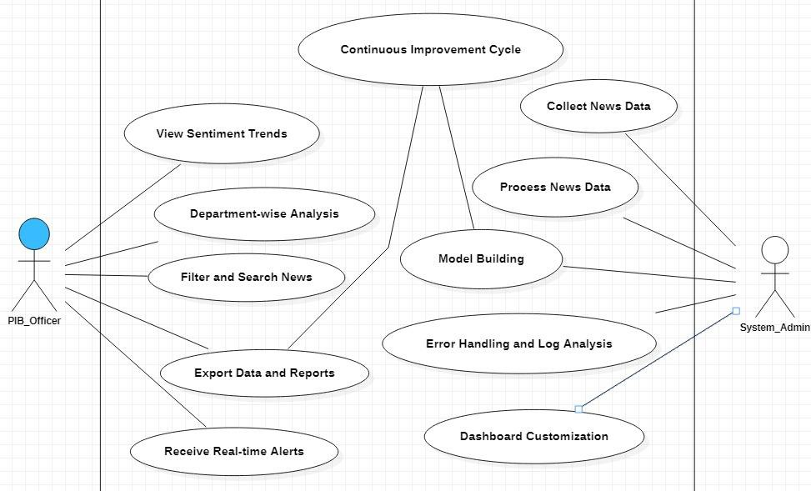
Show Stopper
Use Case
There is no existing platform for Real Time News Feedback.
Helps government to monitoring news coverage and public sentiment
in real-time.
Automation reduces the need for manual monitoring and data collection, saving time and resources.
Government can make data-driven policy decisions and communication
strategies.
The assessment of the impact of government policies and initiatives
based on media and public reactions.
Predictive analytics to forecast potential issues or trends based on historical data.

Slide 4
Team Member Details
Team Leader Name: Mr. Harshal Paratwar
Branch: BE Stream: CS Year: IV
Team Member 1 Name: Mr. Chaitanya Ambekar
Branch: BE Stream: CS Year: IV
Team Member 2 Name: Mr. Vitthal Waghere
Branch: BE Stream: CS Year: IV
Team Member 3 Name: Mr. Santosh Sarvade
Branch: BE Stream: CS Year: IV
Team Member 4 Name: Ms. Asmi Gaikwad
Branch: BE Stream: CS Year: III
Team Member 5 Name: Ms. Riddhi Apar
Branch: BE Stream: ENTC Year: II
Team Mentor 1 Name: Dr. Deepak Uploankar
Category : Academics Expertise : Digital Image Processing, Machine Learning and Deep Learning Domain Experience : 10+ years

